Slide 1
GIT
Version control system

Slide 2
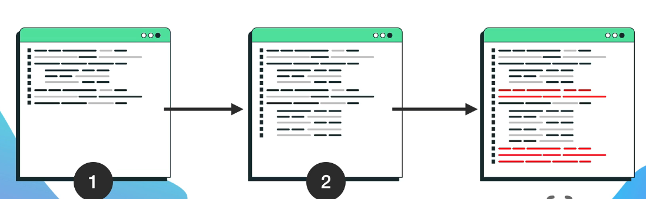
GIT
🔹 Git is the most popular version control system, which allows you to track changes to your code and make it easier to work with your team 👉 Git allows you to revert to any previous version!
Git uses snapshots of your code, so you can: ✔ Compare the current code with old versions ✔ Revert to any previous version ✔ Work with a team without worrying about data loss.

Slide 3

GIT - EXERCISE
- Create an account on GitHub - Install git on your computer

Slide 4
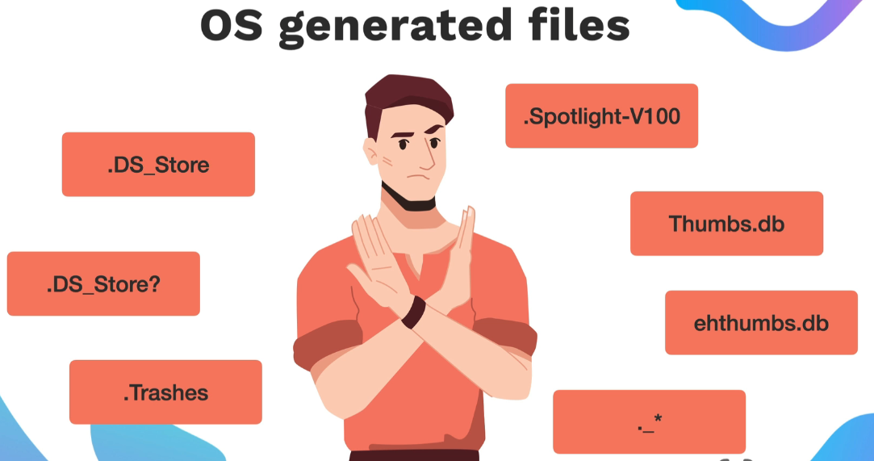
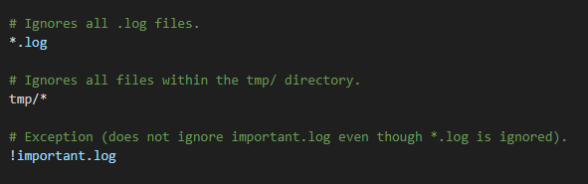
GIT - .GITIGNORE
👉 We use it to prevent certain files from being added to the Git repository. This is extremely important to protect sensitive data (API keys, passwords, private settings) and avoid unnecessary sharing of local settings with the rest of the team

Slide 5
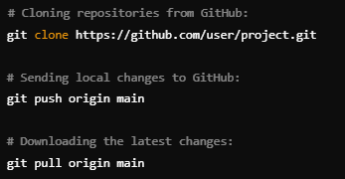
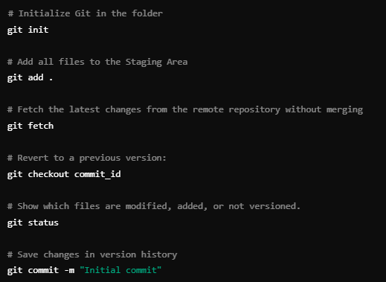
GIT - COMMANDS

Slide 6
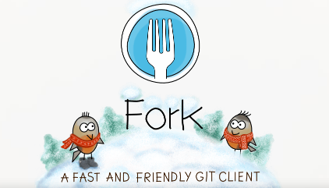
GIT - EXERCISE
✅ Create a local Git repository ✅ Add and commit changes ✅ View commit history ✅ Revert to previous versions ✅ Work with a remote repository on GitHub

